Slide 1
ONLINE PERMIT APPLICATION INSTRUCTIONS

Slide 2
Online Permitting
Evansville Vanderburgh County Building Commission
For questions about applying online call 812-435-5788, 812-436-7879
or
Email permit@Evansville.in.gov

Slide 3
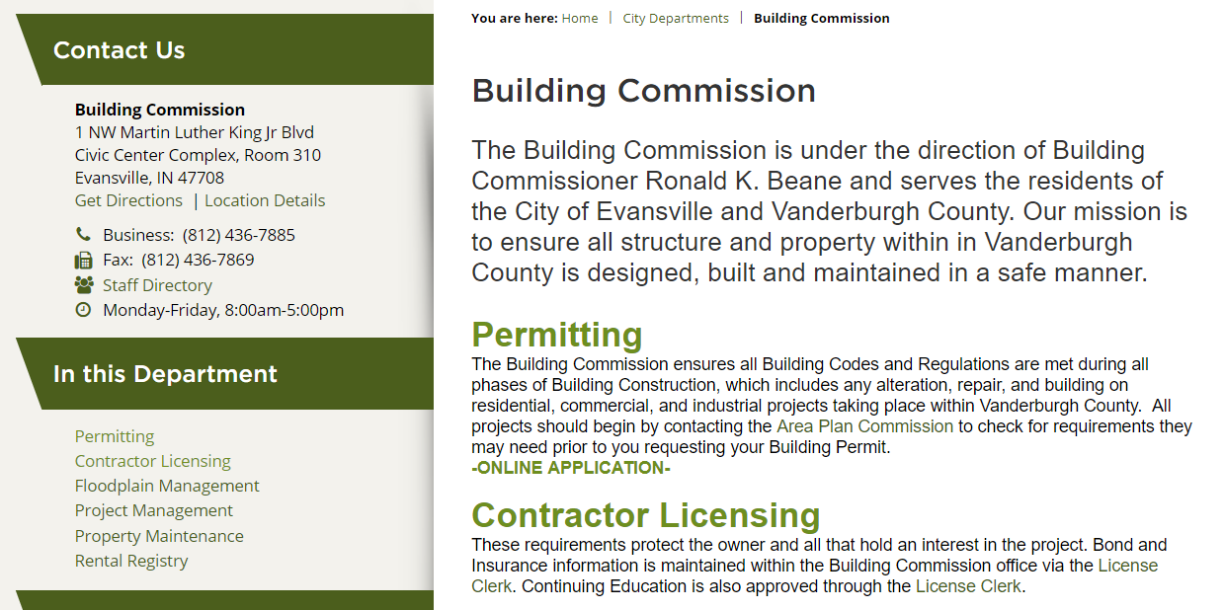
To access our online permitting applications, visit the Building Commission website
and click on the ONLINE APPLICATION under permitting.

Slide 4
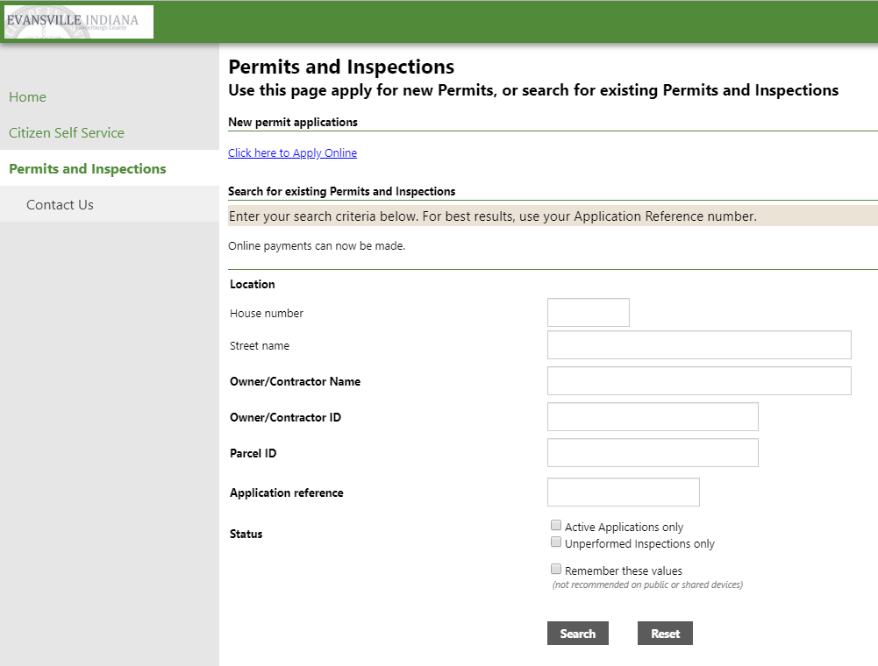
Click on the ‘Click here to Apply Online’.

Slide 5
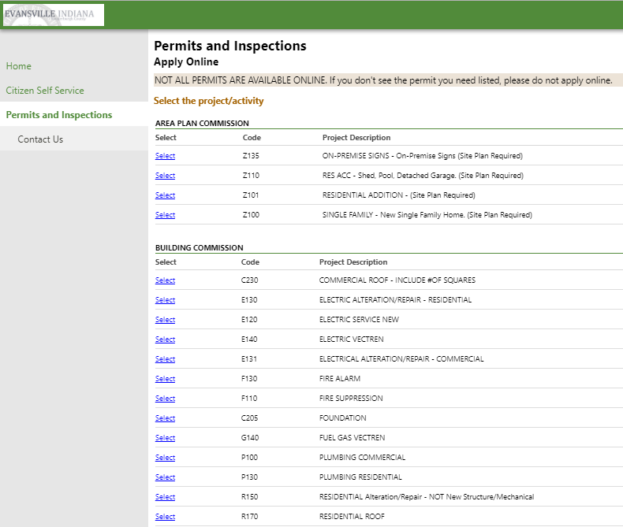
Select the type of permit you are applying for by clicking on the ‘Select’ next to the project description. For this example, I am going to choose ELECTRICAL ALTERATION/REPAIR - RESIDENTIAL.

Slide 6
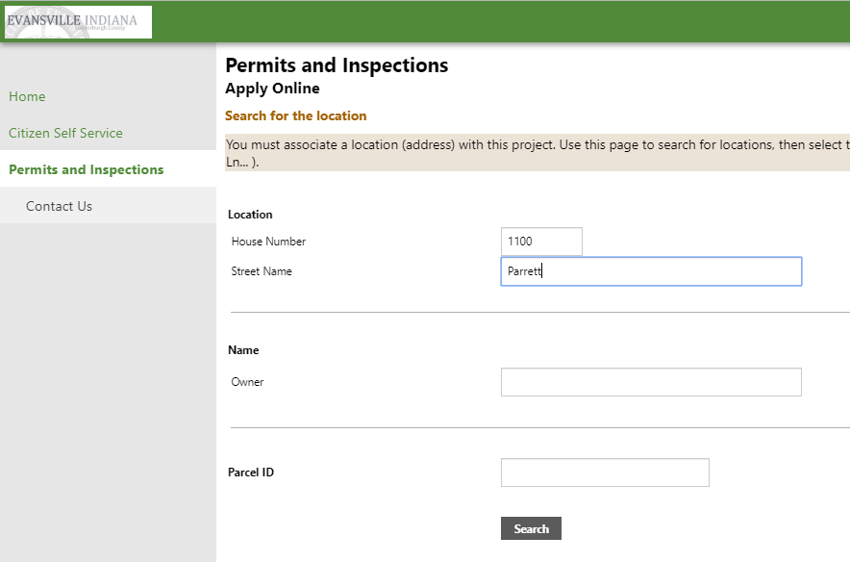
When entering an address, ONLY use the House Number and Street Name field. DO NOT enter direction or street type.
Example: 123 N Main Street. Only 123 and Main should be entered.
Do not use the Owner and Parcel ID field.

Slide 7
On this next page, you may be given an option of several addresses. Choose the one that is the one you are pulling a permit for.
Example: 123 N Main St. Since you can only enter house number and street name, 123 S Main Street may populate as well. Chose the address you are applying for.
Click ‘Select and Continue’ at the right of the screen next to that address.

Slide 8
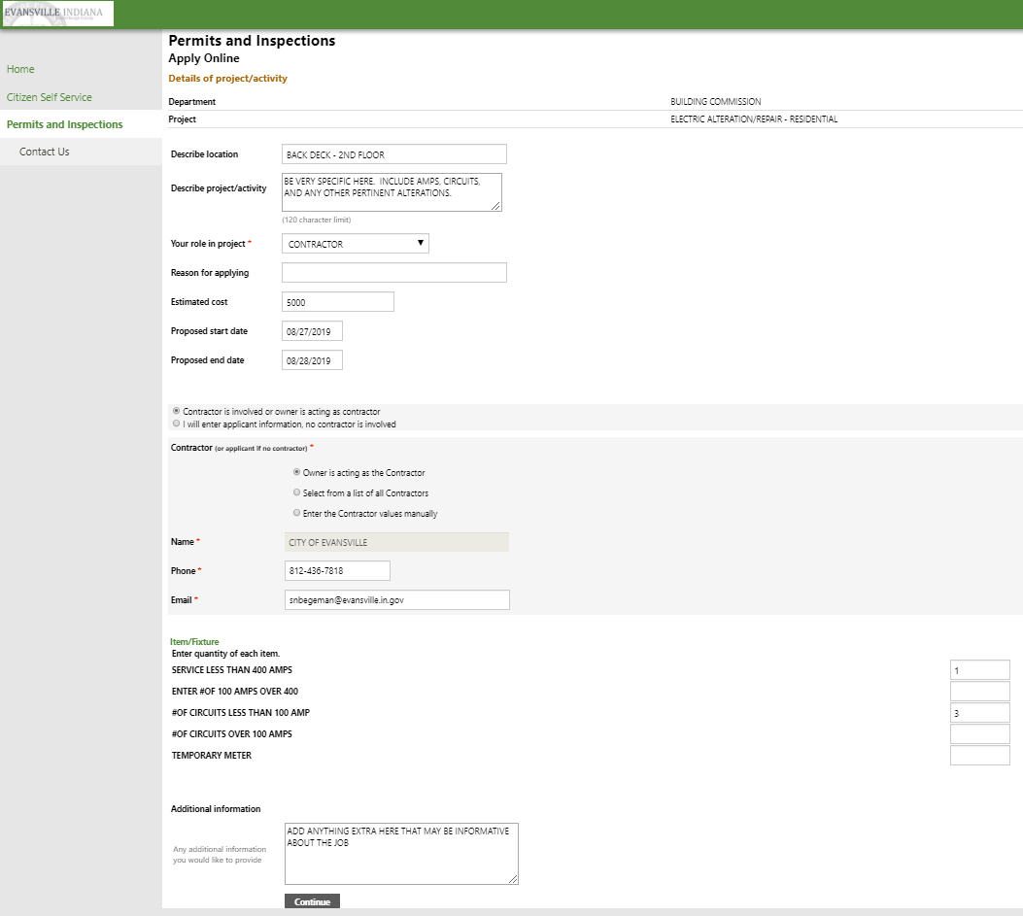
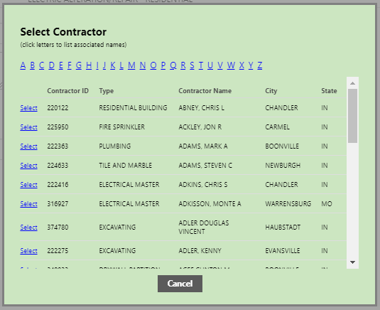
Fill out the online application in as much detail as possible. Enter something in each field if possible. The information you enter in this page is what will establish whether the permit can be issued as applied for.
Describe scope of project here in as much detail as possible.
Estimated cost of labor and materials must always be listed. Do not use commas or periods in your proposed cost.
Select contractor type here. You will be prompted to complete information depending on the type chosen.
Always enter something in these items. This further establishes the scope of work and creates fee/item.
When application is complete, ‘Continue’ to move to next page
When contractor name is found, click ‘Select’.

Slide 9
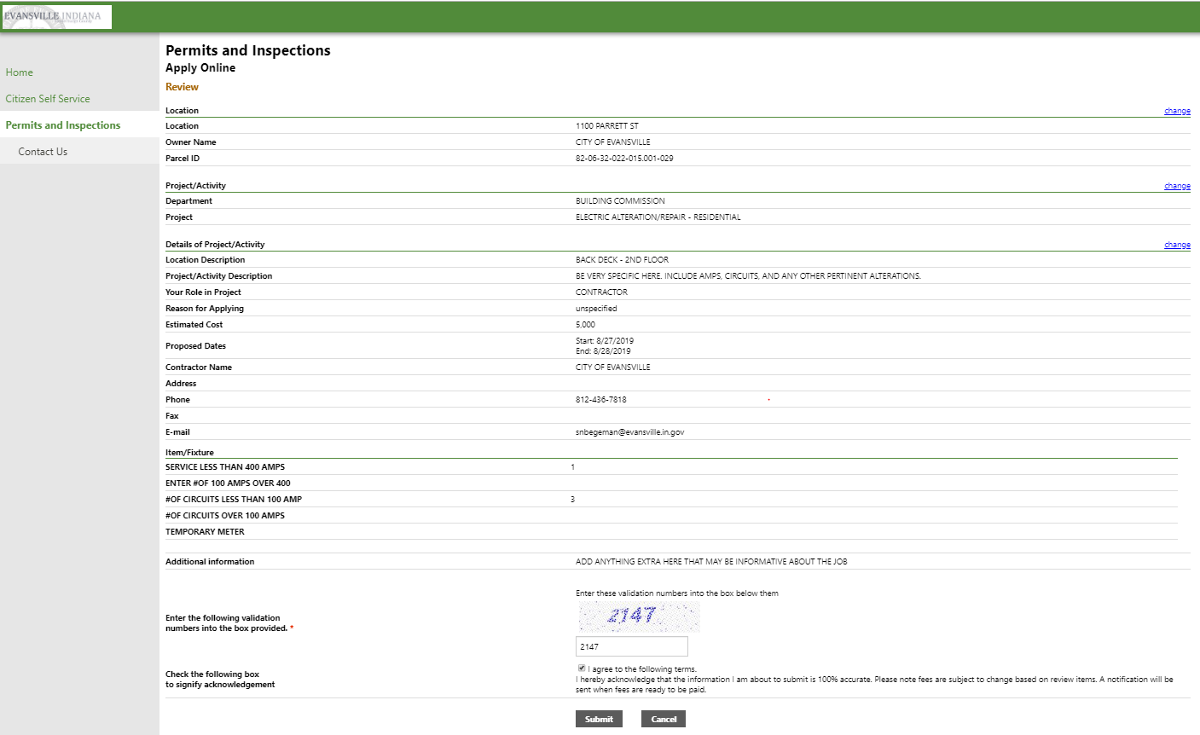
This page is an overview of what you are applying for. You can change any of the information at this point. Review the information before entering the validation code, agreeing to the terms and submitting.

Slide 10
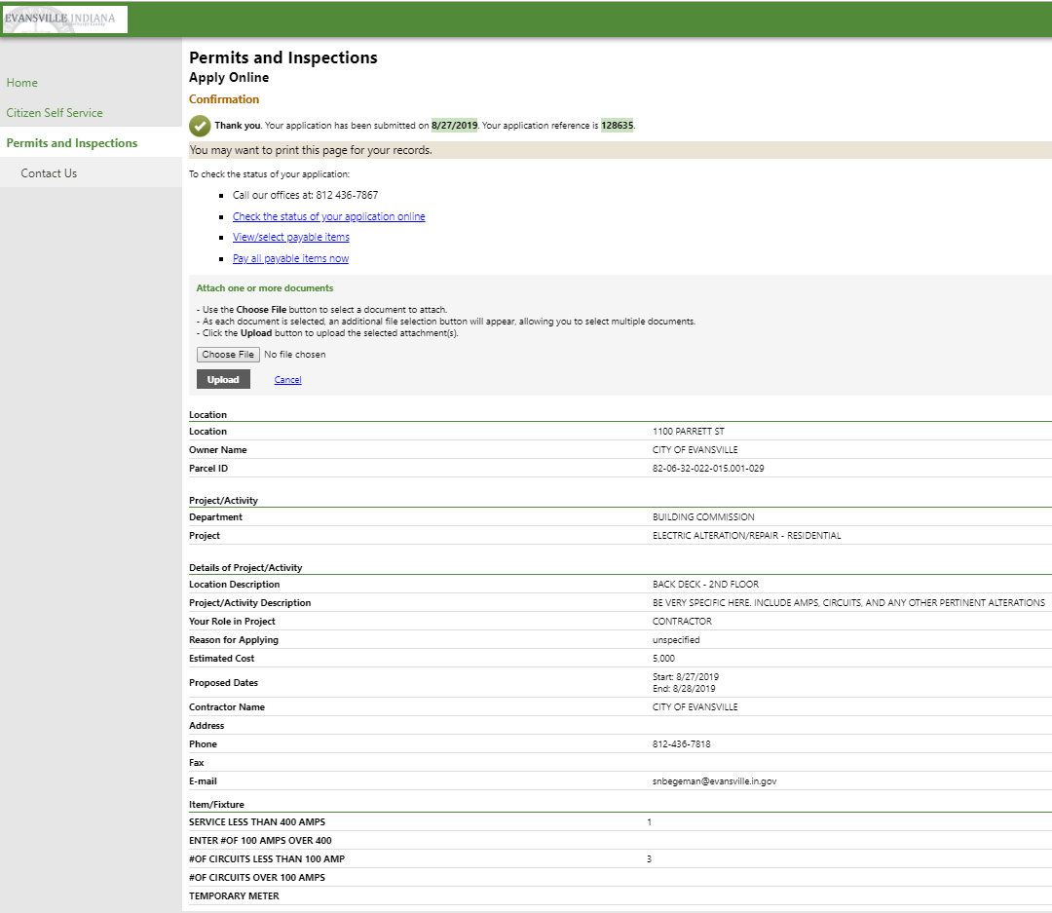
This page shows you an application number as your confirmation. This information will also be sent in a receipt to the email provided on the application.
View/select payable items or Pay all payable items now.
To upload plans, use the attachment options here.

Slide 11
When ‘Pay all payable items now’ is selected, you will be directed to this screen, where your permit is already added to the cart.
At this point, click on the ‘My Cart’ logo at the top right of the screen. You will be given an option at that point to Checkout. This will take you to a screen where you will be able to enter your credit card or e-check information.
After paying for your permit, you will receive an email with your application number and receipt of payment. At this point, do not assume you have a permit. A permit is not issued until your application has been reviewed by the Building Commission.

Slide 12
When the permit has been issued, the Status will show ISSUED.
Click Details to the right of the permit line to View permit image.
When the status shows issued and you are able to View permit image, your permit is issued. You will need to call Nikki Rodenberg at 812-436-7867 for any inspections that will be required for your permit.

